Slide 1
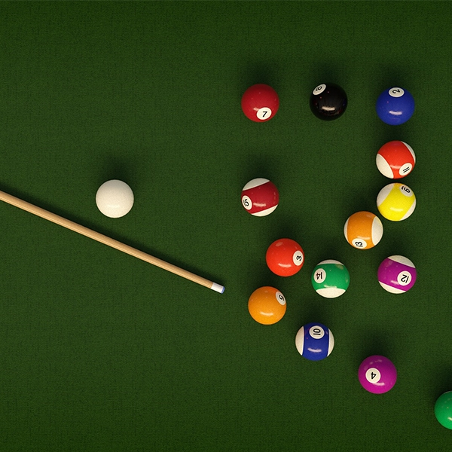
Trajactory Simulation of Billiard Ball
Interm report presentation
-JunHa Kim, DongHa Yoon-
2020.11.26
Notes:
Hello, it’s junha Kim and DongHA Yoon who present intrim presentation of project.
Our project title is Trajactory Simulation of Billiard Ball.
And Let’s start the presentation.

Slide 2
Contents
Background Theory
Conservation of momentum
Types of friction in billiard balls
Basic points
Coefficients
Assumptions
Code implementation
Explain Configuration code
Simulation process
Some figures
Plan to the final project
Notes:
The contents is as follows.
Background study
Basic points,
code implementation, simulation process, plan final project

Slide 3
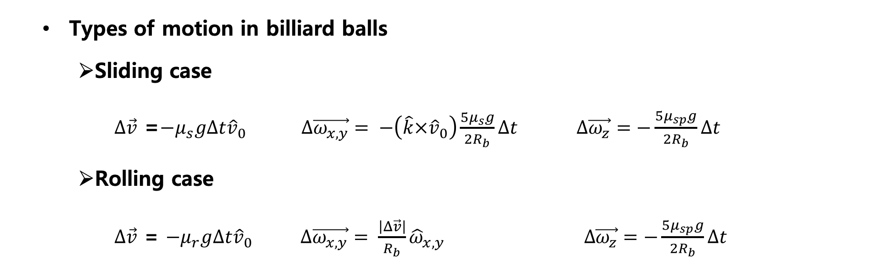
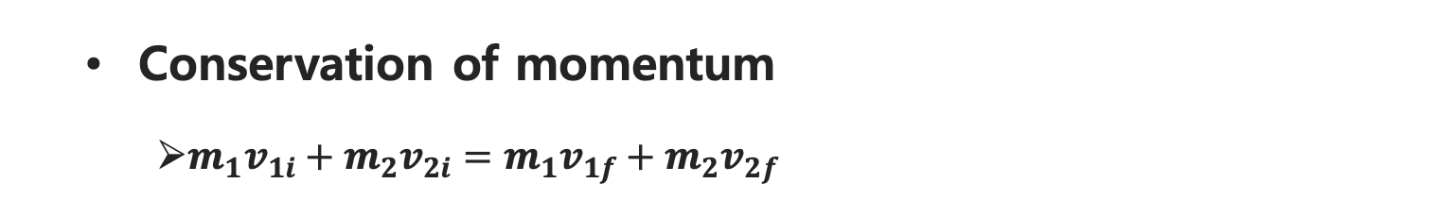
Background study
Conservation of momentum
$m_{1}v_{1i}+m_{2}v_{2i}=m_{1}v_{1f}+m_{2}v_{2f}$
Types of motion in billiard balls
Sliding case
$∆\vec{v}$ =$−μ_{s}g∆t{\hat{v}}_{0}$ $∆\vec{ω_{x,y}}= −\left(\hat{k}×{\hat{v}}_{0}\right)\frac{5μ_{s}g}{2R_{b}}∆t$ $∆\vec{ω_{z}}=−\frac{5μ_{sp}g}{2R_{b}}∆t$
Rolling case
$∆\vec{v}$ = $−μ_{r}g∆t{\hat{v}}_{0} ∆\vec{ω_{x,y}}= \frac{\left|Δ\vec{v}\right|}{R_{b}}{\hat{ω}}_{x,y }∆\vec{ω_{z}}=−\frac{5μ_{sp}g}{2R_{b}}∆t$
$$μ_{s } :Sliding coefficient of friction, μ_{r}:Rolling coefficient of friction,{ μ}_{sp} :Spin coefficient of friction$$
Notes:
The most important physical law in our project is the law of conservation of momentum. As you all know, the momentum conservation is that the first and last momentum are the same, and if we apply it to billiards, you will apply the same amount of momentum to the code as before and after the collision of a billiard ball.
When a ball is struck by the cue, it begins its motion by sliding across the surface of the table. After some time, the interplay between the table friction and the ball’s linear and angular velocities causes the ball to begin rolling. So in our code, the billiard ball's motion is largely divided into sliding and rolling.
The moment when the ball moves from sliding to rolling is when the ball's center velocity and the relative velocity of the ball's contact point are zero.
As shown in the above equation, the coefficient of friction when sliding and rolling are different, requiring different equations. Also, the coefficient of friction between spin and sliding motion is different.
μsp=0.044, μr=0.016 and thereby calculated μs=0.2

Slide 4
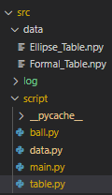
Code implementation
Assumption
Beginning of the motion is a situation in which the ball is hit with a cue stick.
Collision always happen at the middle point of the ball
Script
ball.py
The core module of this project
Computes very ball’s actions
data.py
The module for physical constants, properties about billiard game
table.py
The module for creating billiard tables
Stores data by “.npy” file
main.py
The execution script
Initiates the simulation
Data
Directory for storing Table.
Log
Directory for log files.
Log files are records data for each test cases.
Notes:
Before implementing the codes, we set some assumption.
First, The beginning of the motion is a situation in which the ball is hit with a cue stick.
Second, The height obstacles including rails are same with the ball’s center. So the collision point will be always the center of the ball.
We separated this project by 3 directories.
First one is table data. There are several types of tables, including rectangle table and elliptical table.
Second one is simulation log. There are sub-directories which is classified with each test cases.
Last one is python script. We separated the code by 3 module and 1 main procedure script.
ball.py is the core module that defines billiard ball’s physical properties which includes position, velocity and angular velocity. And defines several methods.
We only have to implement detecting and managing collision process
data.py defines physical coefficients and billiard properties.
table.py creates the table and saves by .npy file. Also it defines visualization code.
main.py is the execution script.

Slide 5
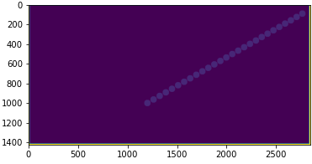
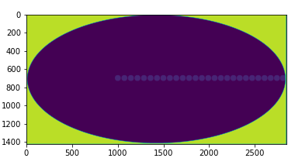
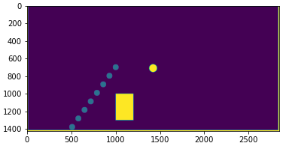
Simulation process
Initialization
V: Cue velocity
pos_x
theta: hit angle
pos_y
b
phi : projection angle
a
billiard table
projected plane
Result
Notes:
Initialization variables are two type.
First type is the ball’s position on the table. pos_x and pos_y
and the second type is about hitting.
phi, a and b specifies the hitting point and theta and V defines cue stick’s motion.
Next part is table selecting and logger creating.
Last part is the main procedure. Because the collision is not implemented, we set the time limit for preventing the infinite loop.
And the result is saved in log directory.

Slide 6
Summary
Summary of our task
Theoretical Background research of billiard games
Completion of simulation code for ball strike motion
Obtain results of ball trajectory(without collision) simulation
Making various shapes of billiard table and obstacle code
Plan for final report
Create Collision Situation Simulation Code and Add Input Validation Checker
Various ways of analysis
The relationship between the number of collisions and the speed
the comparison of the trajectory when there is no spin.
Notes:
Summary of our task
Theoretical Background research of billiard games
Completion of simulation code for ball strike motion
Obtain results of ball trajectory(without collision) simulation
Making various shapes of billiard table and obstacle code
Plan for final report
Create Collision Situation Simulation Code and Add Input Validation Checker
Various ways of analysis
The relationship between the number of collisions and the speed
the comparison of the trajectory when there is no spin.

Slide 7
Thank you
Interm report presentation
-JunHa Kim, DongHa Yoon-
2020.11.26
Notes:
Thank you for listening our project presentation.

